Slide 1
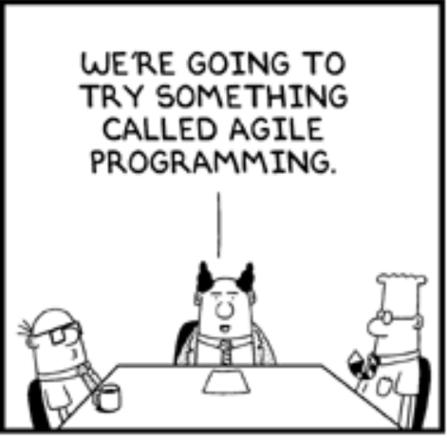
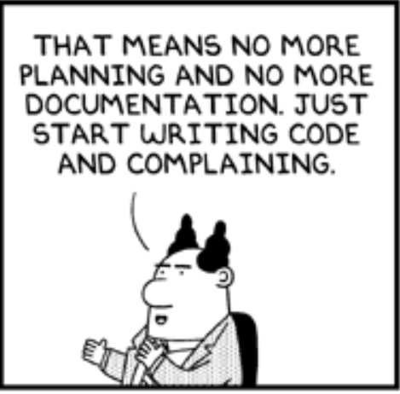
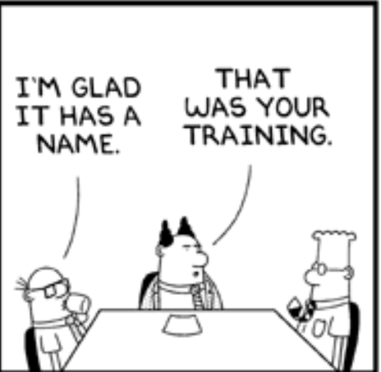
The Story of a and b
Jack still owes me from yesterday.
Is it okay to ask him about the money?
Cheap!
Can I get my $2 back?

Slide 2
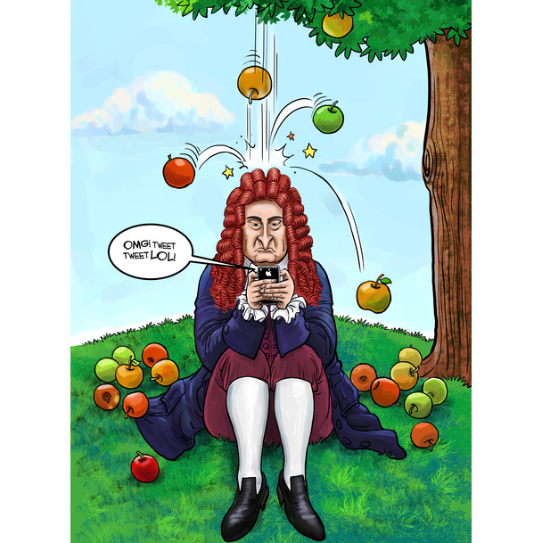

The idea

Slide 3

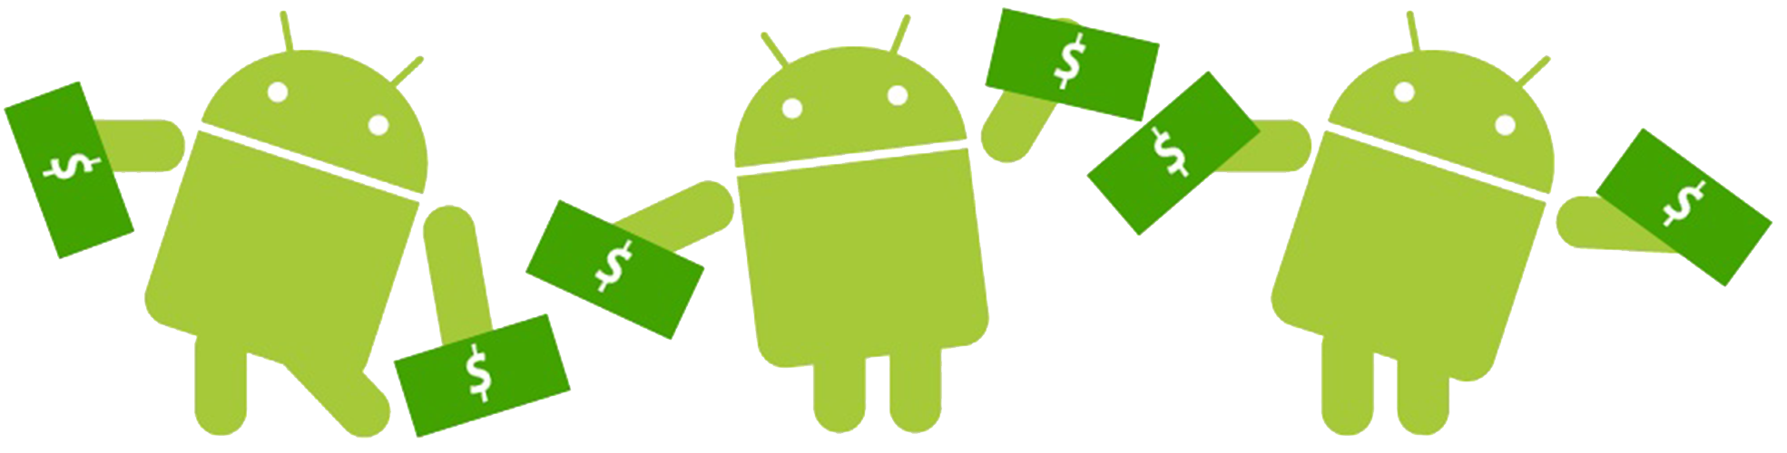
An android expense management tool
Presented by : Team Alpha

Slide 4

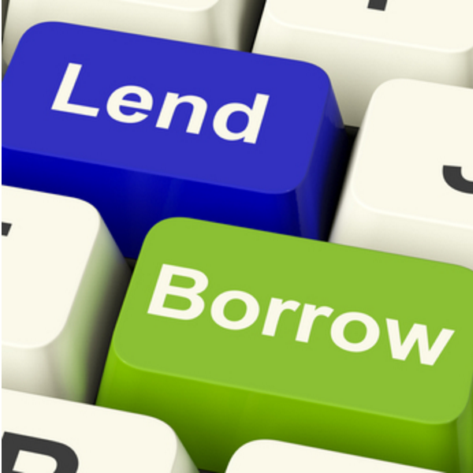
What doES our app do?
Split bills with friends and family
Track your expenses
To live together peacefully

Slide 5

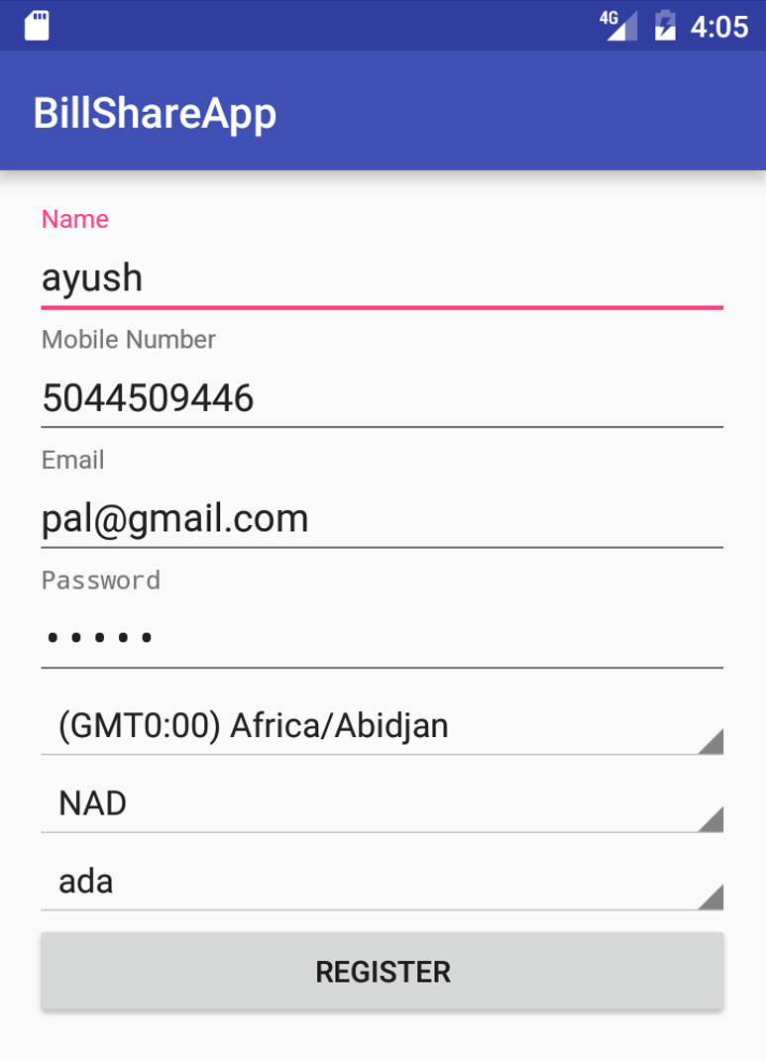




User friendly

Slide 6

Free of cost

Slide 7

Registration

Slide 8

Creating groups

Slide 9








Finding friends

Slide 10
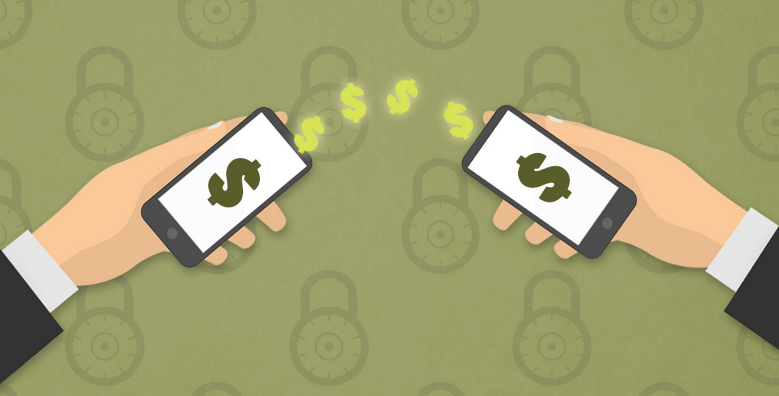
Splitting Bills

Slide 11
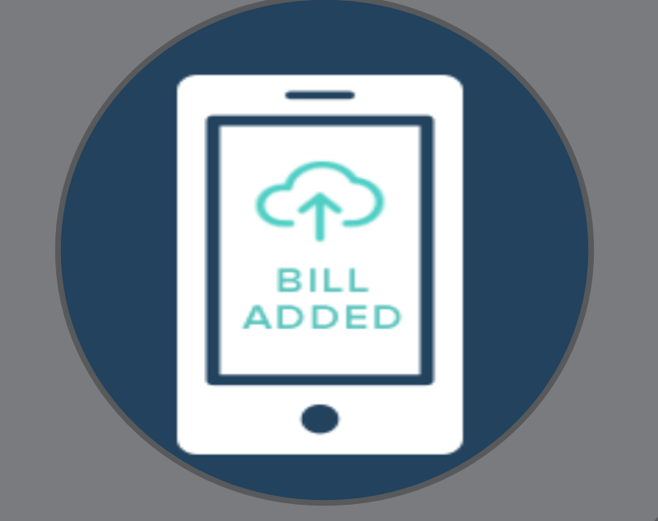
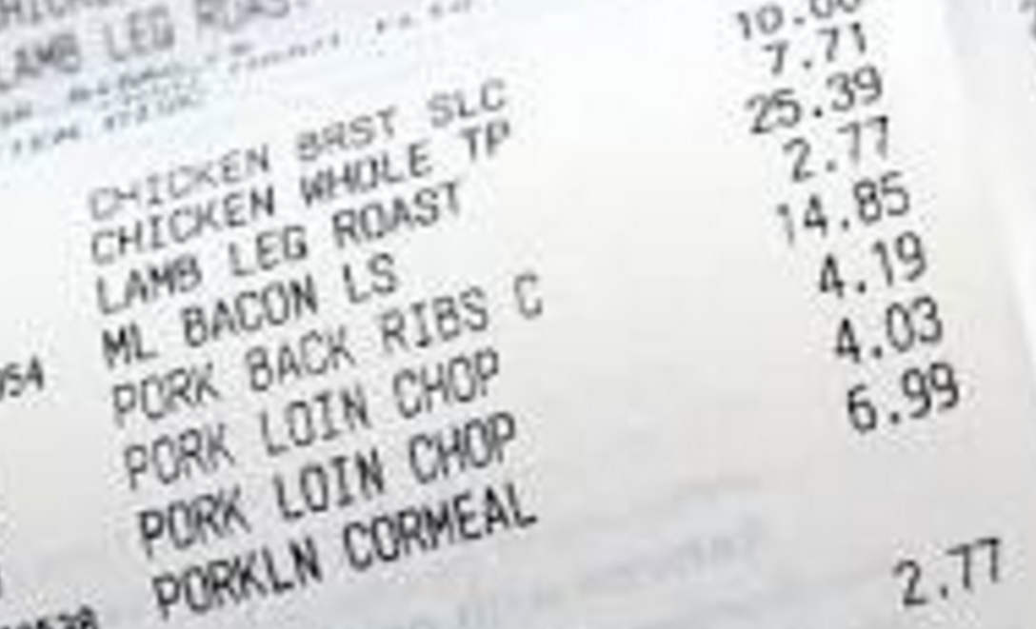
Adding bill image

Slide 12


Budget notification

Slide 13
SHOW TIME GUYS !

Slide 14

Technologies Used
Android Nougat
Spring Boot
Image Retrofit
Firebase Cloud Messaging
Hibernate
MySQL
Android FindBugs
Junit
Espresso
Jenkins
Gradle

Slide 15
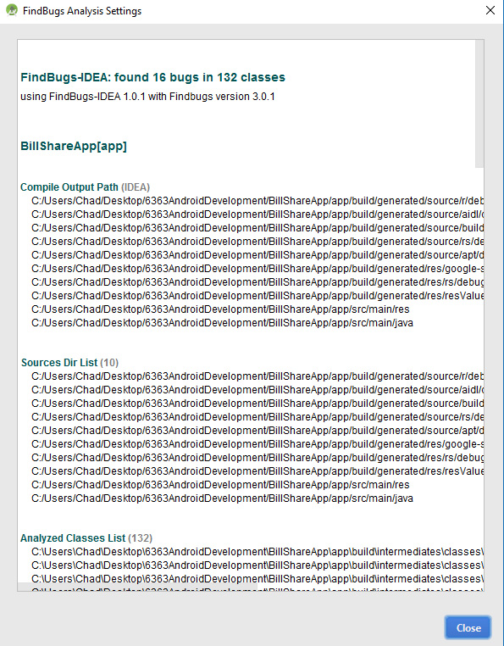
Technologies Used

Slide 16
Overall Learning
Scrum meetings
User stories
Documentation
XP programming practices
Pair Programming
Refactoring
Test driven development
Product Backlogs
Release plan

Slide 17
Comments
Questions

